Slide 1
DIGITAL SEISMOMETER with Earthquake Analyzer

Slide 2
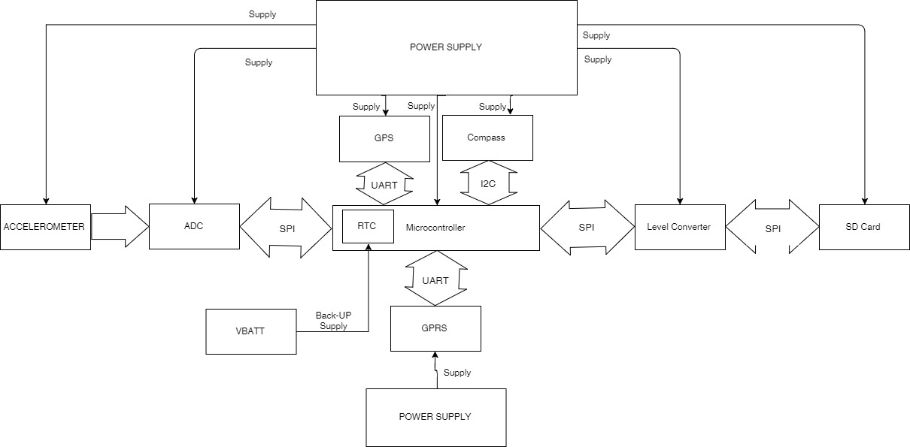
BLOCK DIAGRAM

Slide 3
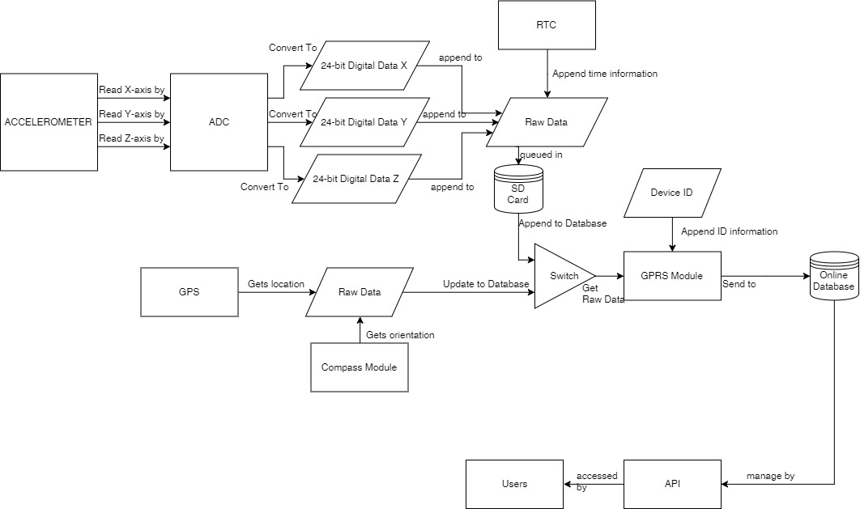
DATA FLOW DIAGRAM

Slide 4
Getting the magnitude

Slide 5
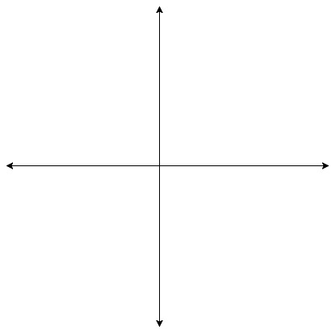
Getting the magnitude
Y-Accel
Res-Accel
Z-Accel
FinaRes-Accel
X-Accel
Res-Accel

Slide 6
FinaRes-Accel
Z-Accel
Y-Accel
X-Accel

Slide 7
Getting the Direction

Slide 8
Getting the Direction
Y-Comp
Y-Accel
Res-Accel
Res-Comp
ΘNorth
Θaccel
X-Comp
X-Accel
Θdirection= Θnorth – Θaccel, angle of direction is the angle with respect to the north axis.

Slide 9
Getting the Distance

Slide 10
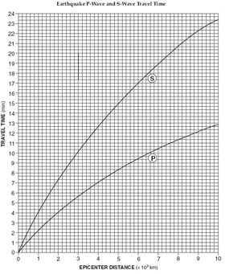
Getting the Distance

